Slide 1
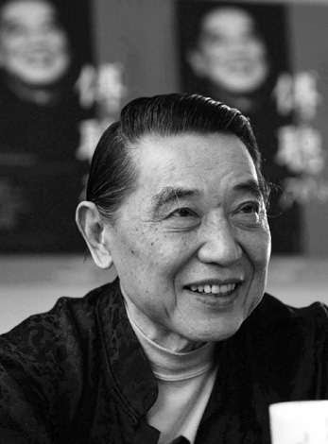
Fou Ts’ong’s Haydn
AMS–SMT Minneapolis
November 9, 2025
Keri Hui
Hong Kong Baptist University

Slide 2
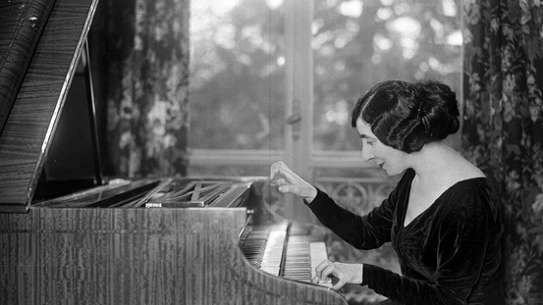
“…How often we still hear people exclaim with some pity and disdain ‘Good old Papa Haydn!’ as if to say, ‘Very nice music, but so childish, so old-fashioned, so poor!’ But Haydn, who, seated at his harpsichord or pianoforte, composed marvels; Haydn, who knew how to arouse passions and transport the soul—why consider his music old-fashioned and poor? It has happened probably because it has been unjustly overlooked and scorned instead of being studied and profoundly grasped…”—Wanda Landowska, 1959

Slide 3
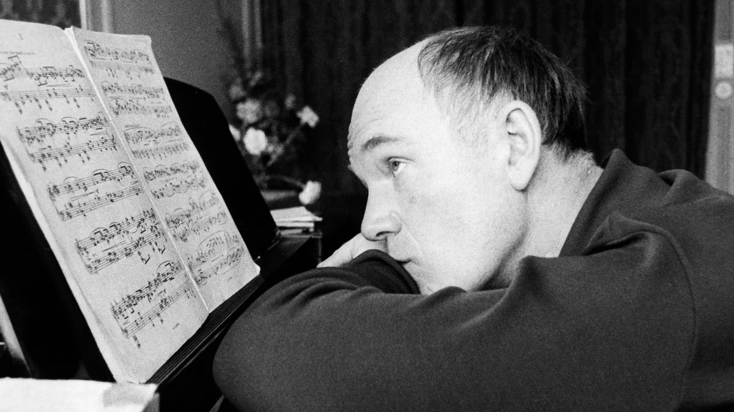
“Dear Haydn, how I love you! But other pianists? They’re rather lukewarm towards you. Which is a great shame.”
—Sviatoslav Richter, 1971

Slide 4
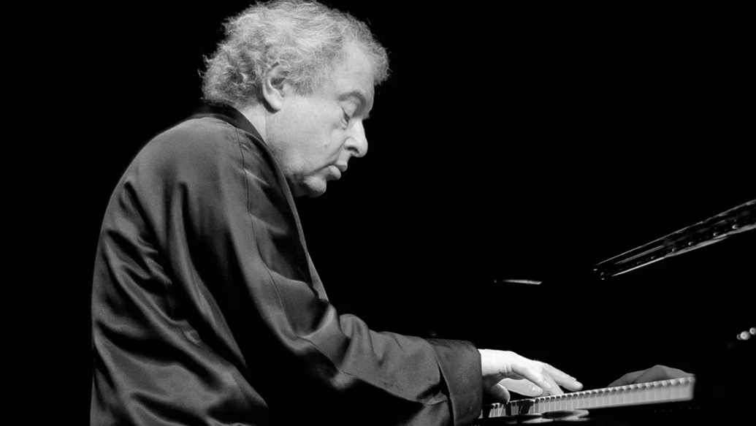
“Papa Haydn has become one of the worst clichés in classical music. It degrades one of history’s most innovative composers into a lovable but minor figure. Most piano students play Haydn’s piano sonatas and one often hears some of them as overtures or introductions to piano recitals. The pianist plays a harmless little Haydn sonata at the beginning of the programme. Afterwards we can get down to the real business of the meatier keyboard music.”
—András Schiff, 1999

Slide 5
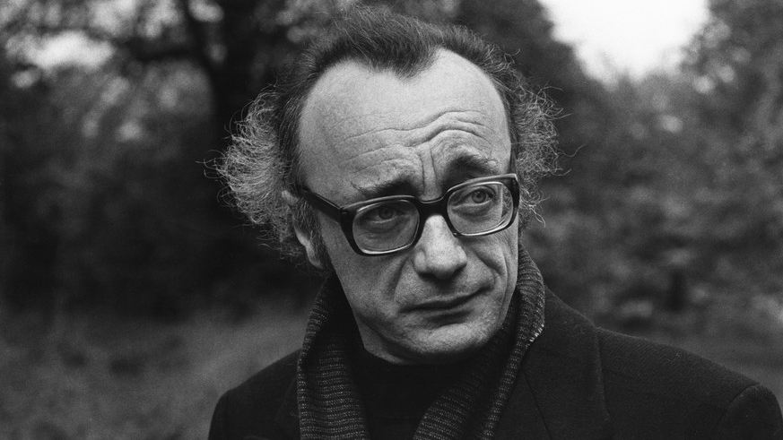
“Our picture of Haydn… in the process of disposing of its nineteenth-century varnish. The always-welcome friend of the house who has nothing new to tell (Schumann), the man who was still mainly seen as a stepping stone for Mozart and Beethoven by Hanslick or Adorno, is giving way to the figure of an explorer and adventurer, a grandmaster of surprise, a creator of his own musical universe who introduced the comical into absolute music.”
—Alfred Brendel, 2010

Slide 6
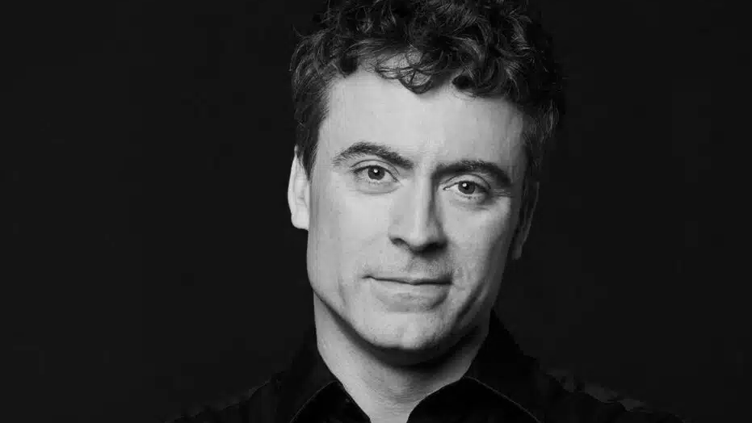
“It’s time for his music to be just as widely programmed as that of his peers, Mozart and Beethoven…[Haydn’s] range is huge, his humour is like no other composer’s and his slow movements can be incredibly tender and heartfelt… Haydn is mischievous and doesn’t want to hurt anyone – he just wants to make you laugh.”—Paul Lewis, 2021

Slide 7
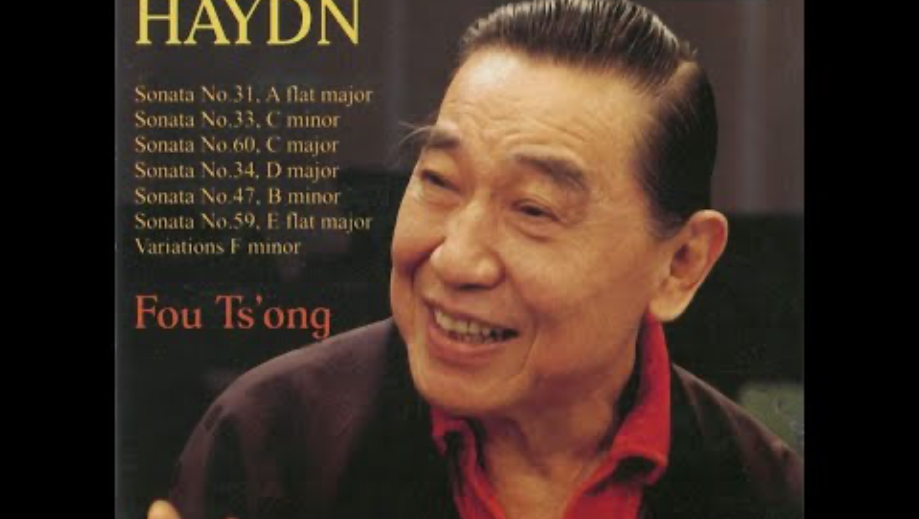
Fou Ts’ong performs Haydn for his latest CD | Meridian Records UK 2009

Slide 8
Fou, 1991: “Haydn is an incredible composer. I like his compositions very much. But the world… allows many different types of genius. Haydn’s genius and Mozart’s genius are entirely different. Beethoven’s is closer to that of Haydn. Mozart’s originality is without trace and unintentional. Haydn differs in that while his whimsical ideas and tricks are products of genius, they are traceable. Haydn’s compositions are full of flavour and humour, with extremely rich content. The splendidness of his instrumentation and the profundity of his slow movements are memorable. Beethoven’s slow movements were influenced by Haydn and not Mozart.”
(“海頓是了不起的作曲家,我也很喜歡他的曲子。不過這世界…可以容納很多非常不同的天才。海頓的天才與莫扎特的天才完全不同,貝多芬比較接近海頓。莫扎特的獨創性是不見痕跡的，不是故意做出來的；海頓則不然，很多妙想與點子雖仍是天才之作，卻有痕跡。海頓的作品很有味道，充滿了幽默感，而且內容非常豐富。他的配樂之豐富，慢樂章之深刻，都令人難忘。貝多芬的慢樂章是受海頓而非莫札特的影響。”)

Slide 9
Fou on Haydn, 2009:
“pure humor” (”純正的幽默”), contrasting Mozart’s “tearful humor” (“幽默中帶淚”)
“without an excessive sense of ego” (“沒有過度的自我”)
“a great degree of wisdom and jingjie”(“很高的智慧和境界”)
“earthy,” characterized by a sort of “rustic simplicity” (“跟土地很接近, 很質樸”)
Haydn’s slow movements embody “philosophical reflection [or contemplation]”; “the more you understand them, the more profound and moving they become” (“…慢板樂章…帶有哲學式的思考,你越了解越是深刻感人”)

Slide 10
Haydn = “antique-like” and irrelevant?

Slide 11
Mozart: “…There is no one who can do everything—to joke and to terrify, to evoke laughter and profound sentiment—and all equally well, except Joseph Haydn”
Carl Ludwig Junker: Haydn is “a man who seems to be made for humour”
Christian Friedrich Michaelis: Haydn is the “greatest master” of humorous music and “the first to do this in overall effect, and awakened a large number of famous composers of the most recent times to write in this manner” (1807)
Fredrick Silverstolpe: “everyday” humour was one of Haydn’s “two physiognomies”; the other being the “penetrating and serious, when [Haydn] talked about the sublime”

Slide 12
G.A. Griesinger: “…in Haydn there was complete confirmation of Kant's observation ‘that the author of a product which he owed to his genius did not himself know how he found within himself the ideas for it, nor did he have it in his power to think out such at will or methodically and to instruct others how they might produce similar works.’”
Kant: “The power of imagination… is either inventive (productive) or merely recollective (reproductive). But the productive power of imagination is nevertheless not exactly creative, for it is not capable of producing a sense representation that was never given to our faculty of sense; one can always furnish evidence of the material of its ideas.”

Slide 13
Fou emphasized, in playing Haydn’s keyboard sonatas, both (intellectual or rational) understanding and (sympathetic) imagination, both qualities highlighted by eighteenth-century philosophers (“若想將海頓的奏鳴曲演好, 一方面是理解, 一方面是想象”)
Fou argued a student’s musical ability and gift can be most effectively evaluated through his or her playing of Haydn’s keyboard sonatas (“看一個學生的音樂才能, 就看他彈海頓的奏鳴曲”)
Fou believed a student’s performance of Haydn’s music can most immediately reveal his or her degree of imagination and level of musical instinct (“可以馬上看出這個孩子的想像力, 以及對音樂直感的能力”)
“Eighteenth-Century Philosophical Listening” (Botstein 1997/1998)
“The starting-point for Haydn as a composer was the eighteenth-century strategy best articulated by Kant that might properly be termed ‘philosophical listening’”

Slide 14
Kant in Critique of the Power of Judgment (1790):
Aesthetic judgment is a “subjective play of the powers of the mind” that is “harmonious even in their contrast”
“For just as imagination and understanding produce subjective purposiveness of the powers of the mind in the judging of the beautiful through their unison, so do imagination and reason produce subjective purposiveness through their conflict…”
“The mental powers, then, whose union (in a certain relation) constitutes genius, are imagination and understanding.”

Slide 15
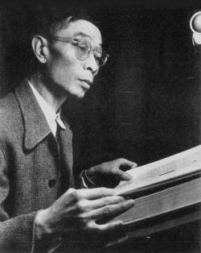
Fu Lei (Fou’s father)’s Haydn (From Fu’s “Beethoven’s Works and Their Ethos” (“貝多芬的作品及其精神”)
“Haydn’s religious music forbids any mystical atmosphere; it is empty, highly secular work, because the masses demanded at that time are concerts in disguise; only something that combines a mix of operatic melodies and pleasing technical expression could arouse the audiences’ interest. The popular view shuns reflections on the mysteries of life and death. Therefore, Haydn’s melodies are innocently and solidly structured, with all phrases being beautifully harmonious; they captivate the ear and satisfy the intellectual demands but never communicate profound and moving speech Even though Haydn was a kind and devout ‘good Papa,’ he could not escape the constraints of his time: a lack of passion.”
(“海顿的宗教音乐也不容许有何种神秘的气氛,它是空洞的,世俗气极浓的作品.因为时尚所需求的弥撒曲,实际只是一个变相的音乐会;由歌剧曲调与悦耳的技巧表现混合起来的东西,才能引起听众的趣味.流行的观念…不愿参透生与死的神秘.所以海顿的旋律是天真地.结实地构成的,所有的乐句都很美妙和谐;它特别魅惑你的耳朵,满足你的智的要求,却从无深切动人的言语诉说.即使海顿是一个善良的.虔诚的"好爸爸,” 也逃不出时代感觉的束缚:缺乏热情.”)

Slide 16
1. Rethinking Humour
Although overemphasizing Haydn’s musical humour has historically led to some distorted depictions of the composer, the unhelpful consequences of defining Haydn and evaluating the value of his music solely in terms of humour has been acknowledged. As Fou proclaimed, echoing eighteenth-century understanding , Haydn’s humor does not contradict but reveals the philosophical depth of his music.

Slide 17
2. Chinese Reception of Haydn
Recent Chinese premiere of Haydn’s opera Il mondo della luna as part of the 2023 Beijing Music Festival, which took place on September 23 and 24 at the Dahua City Center for the Performing Arts
2024/25 Concert Season of China National Symphony Orchestra based in Beijing: “Haydn’s String Quartet Concert,” “Haydn’s Chamber Music Compositions,” “Haydn’s Symphony,” and “Haydn’s Four Seasons”

Slide 18
3. Intercultural Hermeneutics
Bruce Janz: “intercultural hermeneutics can take many forms and have many goals”
“a method for facilitating dialogue across cultures, with a view to accessing emic content (e.g. Michrina and Richards 1996; Geertz 2003)”
“a way of comparing cultural traditions (Mall 2000)”
“a way to create new philosophical questions that come from and resonate with a geographic and cultural place (Janz 2009)”

Slide 19
“The Sublime Extends to Chinese Aesthetics” (Johnson and Clewis, 2025)
Guō Xī (郭熙) (c. 1020–1090 C.E.): an important artist who contributed to Chinese aesthetics of the sublime and wrote the treatise The Lofty Message of Forests and Streams (Línquán Gāozhì 林泉高致)
Huang Binhong (1865-1955), one of Fou’s (and his father’s) favourite painters, admired Guo deeply: Huang’s painting, Lofty Message of Forests and Streams (Línquán Gāozhì 林泉高致), used a title borrowed from Guo, and was intended to be a tribute to Guo
Fou encouraged his piano students to study and take inspirations from Huang’s paintings

